Slide 1

Health Benefit Meeting
Online - TEAMS
2/03/2022
3:45 PM

Slide 2
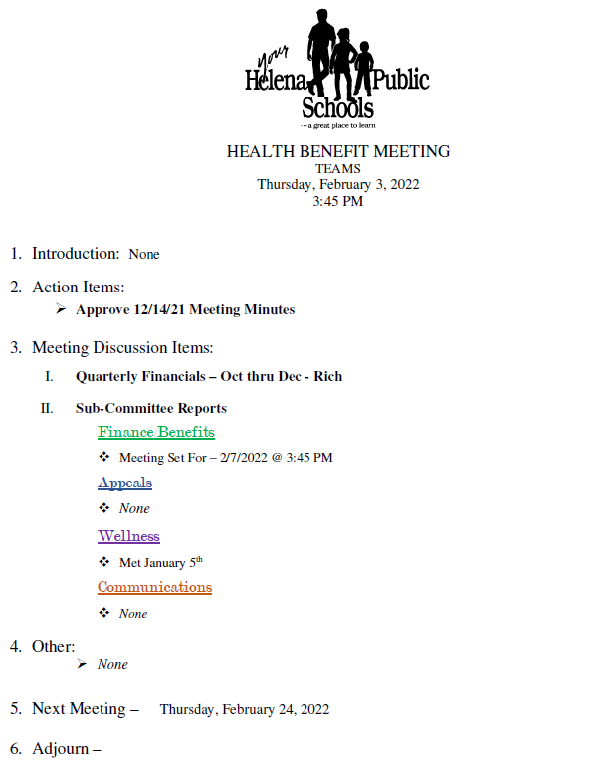

Slide 3

ACTION ITEMS:
Approve 12/14/21 Mins

Slide 4
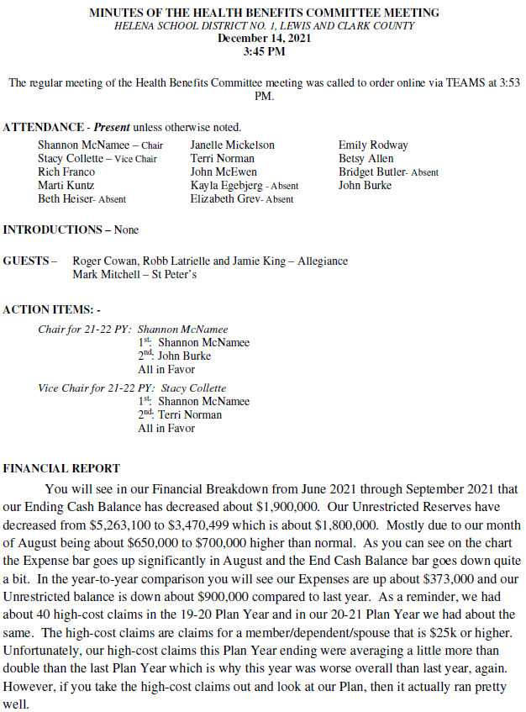

Slide 5
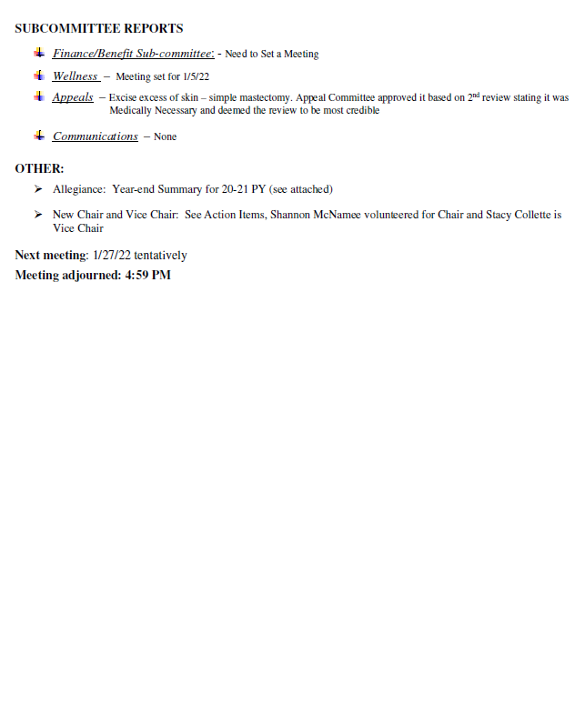

Slide 7
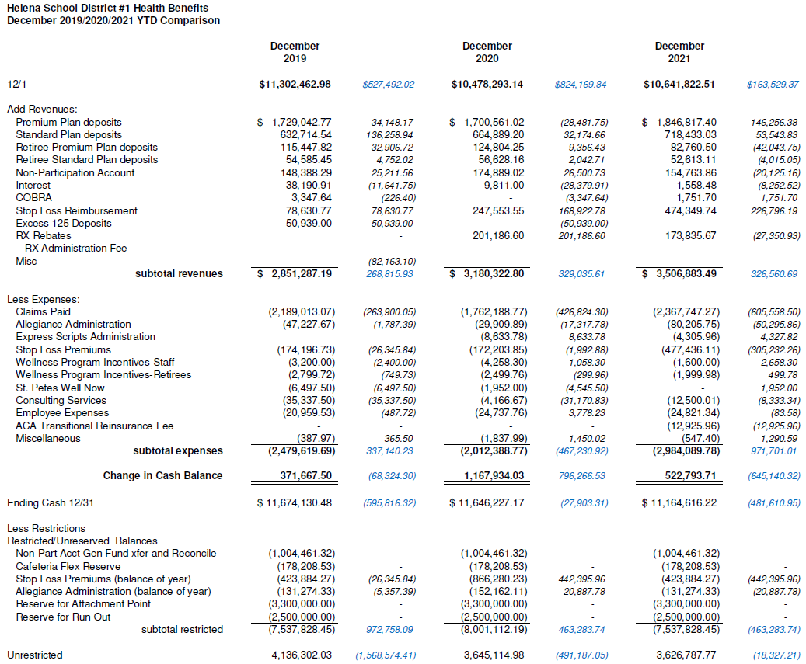

Slide 8
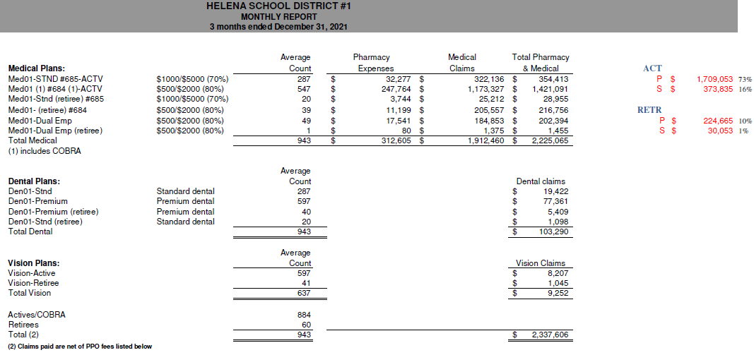

Slide 10



Sub-Committees
Finance/Benefits
Meeting Set for 2/7/22
Appeals
None
Wellness
Met 1/5/22
Communications
None

Slide 11

Other? Questions?

Slide 12

Next Meeting 2/24/22

